Slide 1

Media arts and sciences
N299 PORTFOLIO

Slide 2
What is the goal?
During your career search and development, learning how to interview and how to represent yourself during the career search process is critical.
Each specialization of a Media Arts and Science (MAS) professional also has the burden of proof of showcasing their technical knowledge, eye and understanding of design, understanding of client needs, and applying those skills towards serving that client’s and their audience.
You must pass this portfolio review before being advancing further in your specialization.

Slide 3
N299 Portfolio Review TIMELINE
Week #1 - Portfolio Review Assignment Opens Per MAS Specialization
Week #4 - First Round Submissions due/Assignment Closes
Week #6 – First Round Faculty Feedback due
Week #12 - Any student asked to Resubmit Edits to Portfolio Submission, deadline closes
Week #15 - Receive Final critique and review of second portfolio attempts

Slide 4
overview
We will briefly go over the requirements for each specialization.
This is just a summary; for specifics please see the google doc that will be uploaded to canvas.

Slide 5
3D Graphics AND animation

Slide 6

Design understanding
Create a 1 page website, well branded and designed to display (3) fully polished stills or Illustrations showcasing your fundamentals of design knowledge and understanding

Slide 7
TECHNICAL AND APPLIED UNDERSTANDING
Submit (1) Demo reel showcasing your 3D work (video) 2min maximum
1 new Project Proof of Understanding/ Art Test
Pick an object from a specified folder to make and showcase

Slide 8
deliverables
All material should be present on a website of the student’s own make and design.
All reels/videos should be included on website (maximum 2 minutes)
Include updated resume
Exported as 1920X1080 H.264 23.98 fps or 29.97 fps

Slide 9
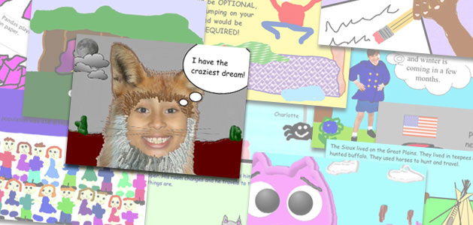
Digital storytelling

Slide 10
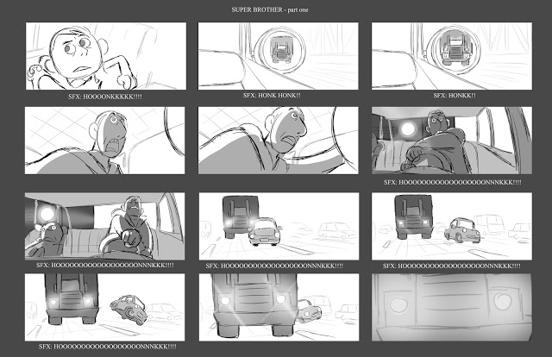
Design understanding
Create a 1 page website, well branded and designed to display (6) fully polished Illustrations showcasing your fundamentals of design knowledge and understanding elegantly.

Slide 11
Design understanding continued
Identify a potential client for a brand and brand strategy redesign, showcase the following with justifications:
Client brand design iterations
Design brief justifying new brand, brand strategy and core audiences
Storyboards for 30 second commercial
Social Media campaign strategy document

Slide 12
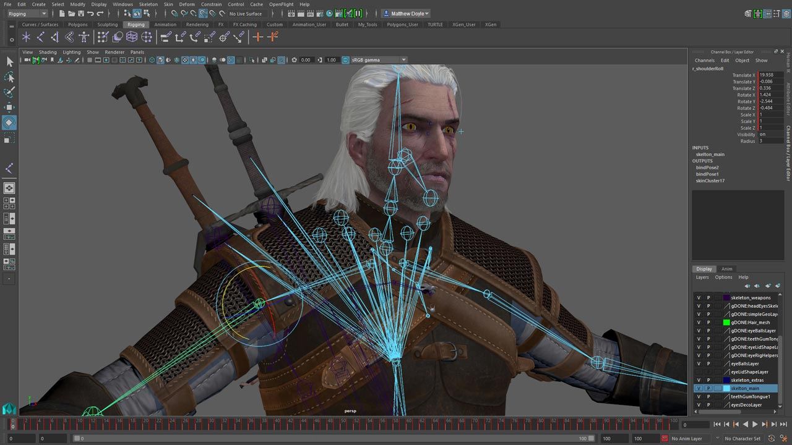
Game design AND Development

Slide 13
Game Design and Development – CORE
One full-featured analog game, professionally produced including printed packaging
A design journal detailing testing done on the game, include interaction(s)
One fleshed out game level
A listing of 10 game design ideas you would like to pursue, including 1 page of sketches for each design idea.

Slide 14

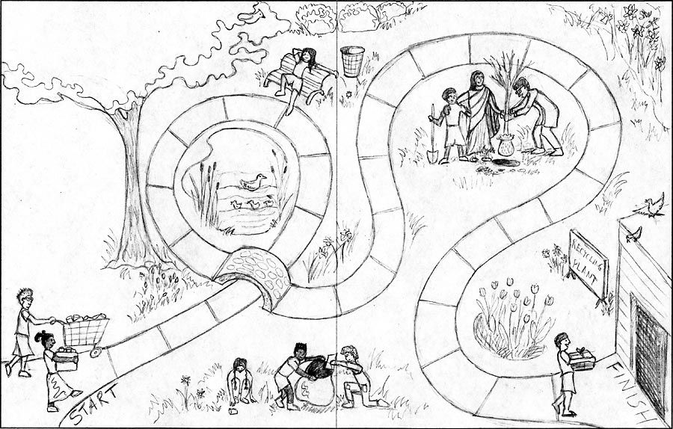
Game design and development - core

Slide 15
Game development portfolio rubric
Working game of memory, with visual refinements for added game feel
Example of one personal programming project not present in any class assignment, produced in a game engine of the student’s choice – Godot, Unity, Unreal, GameMaker, etc.

Slide 16
Game art rubric
Demo reel of your work
N243 (Bouncing ball or solar system)
A personal object of your design imported into unity / Unreal engine and used in a level of your own make
A playable build of a game level/character you have created. Include an artist statement that describes the goals and intended affective/emotional outcome from the level experience.

Slide 17
deliverables
All documentation material should be present on a website of the student’s own make and design.
IF you have a GIT repository, please feel free to share it.
All students must include the CORE in their portfolio review submission, in addition to either the game development or game art requirements.

Slide 18
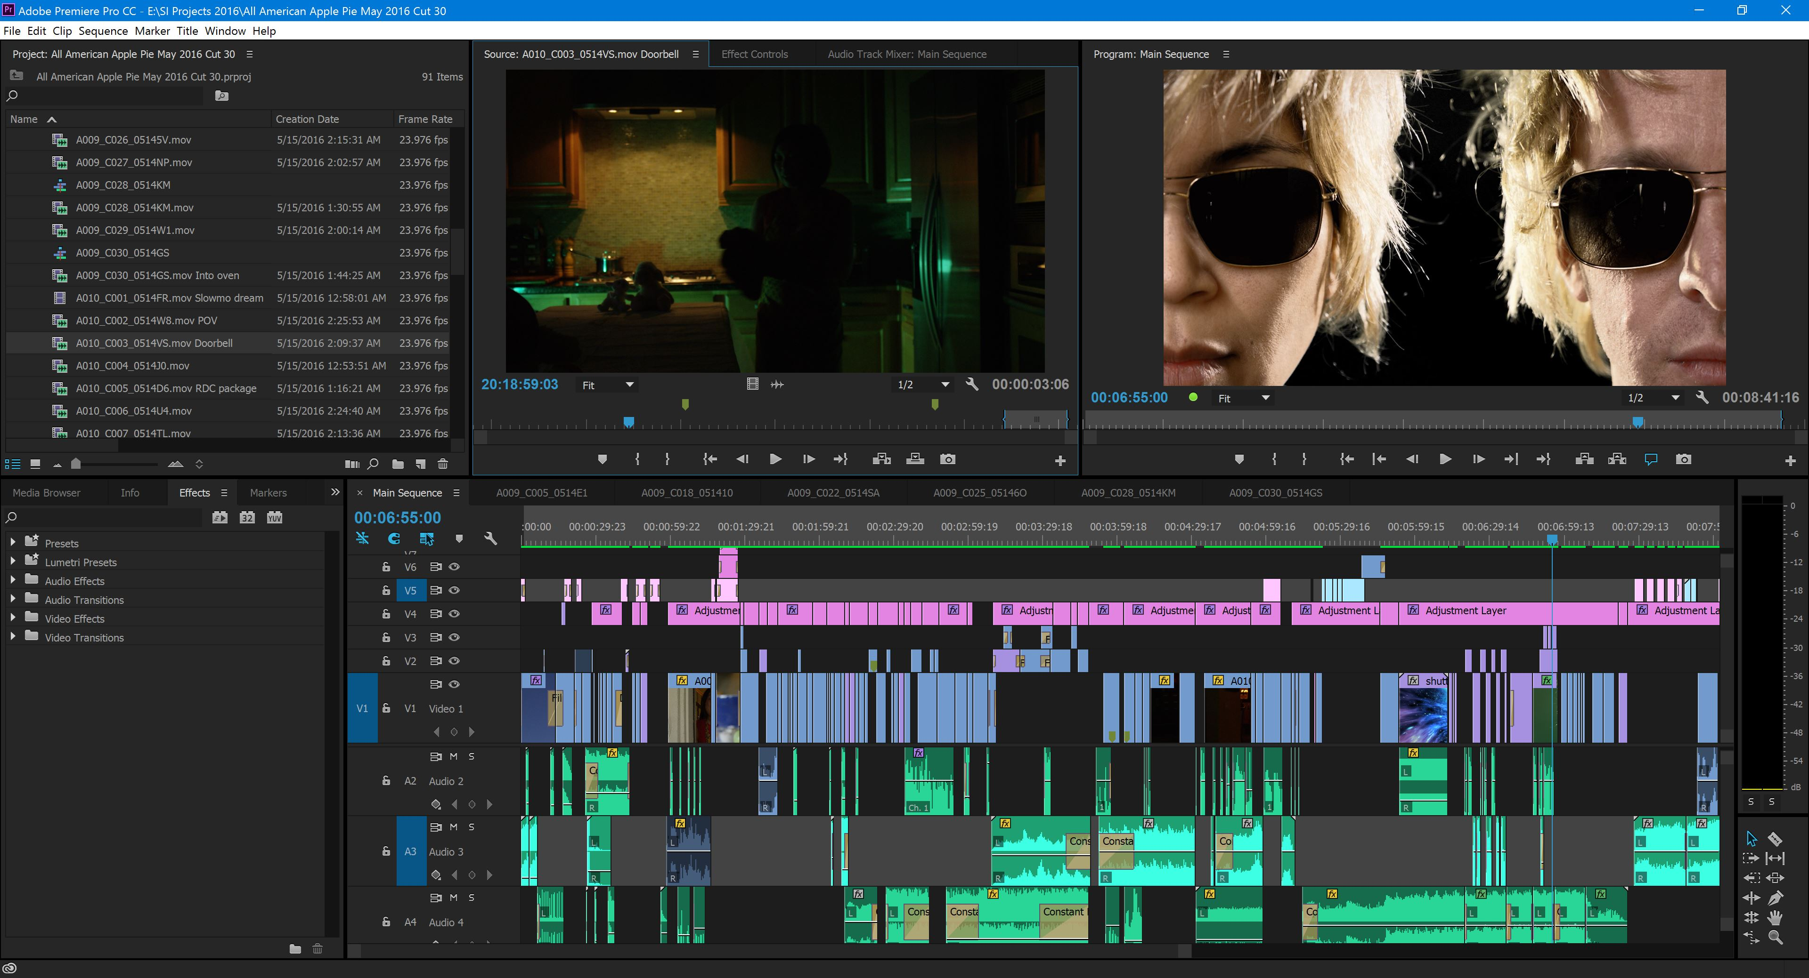
Video production and sound design

Slide 19
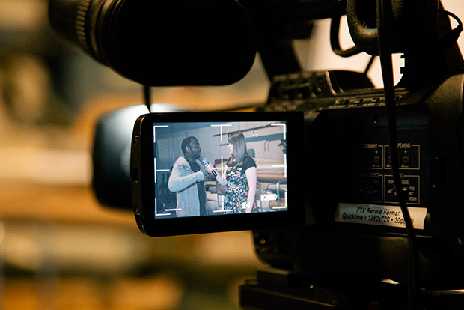
Documentary Reel examples demonstrating a basic understanding of
A-Roll Shooting
B-Roll Shooting
A/B Roll Editing

Slide 20
Reel for documentary should observe the following format
Three 20-second excerpts of interviews totaling 1-minute, followed by:
1 minute of B-roll examples showing a minimum of 12 shots, followed by:
90-second excerpt from A/B Rolled piece, may include walk-and-talk
In a 5-second graphic after each excerpt, indicate what you were responsible for in the production and post-production of the preceding example.
Deliverable: Exported as 1920X1080 H.264 23.98 fps or 29.97 fps.

Slide 21

Narrative Reel examples demonstrating a basic understanding of
Shooting
Directing/Editing

Slide 22
Reel for narrative observes following format
One 3-minute continuous excerpt from final edit of narrative piece, or
Two 90-second continuous excerpts from final edit of narrative pieces, or
Three 1-minute continuous excerpts from final edit of narrative pieces
In a 5-second graphic after each excerpt, indicate what you were responsible for in the production and post-production of the preceding example.
Deliverables Exported as 1920X1080 H.264 23.98 fps or 29.97 fps.

Slide 23
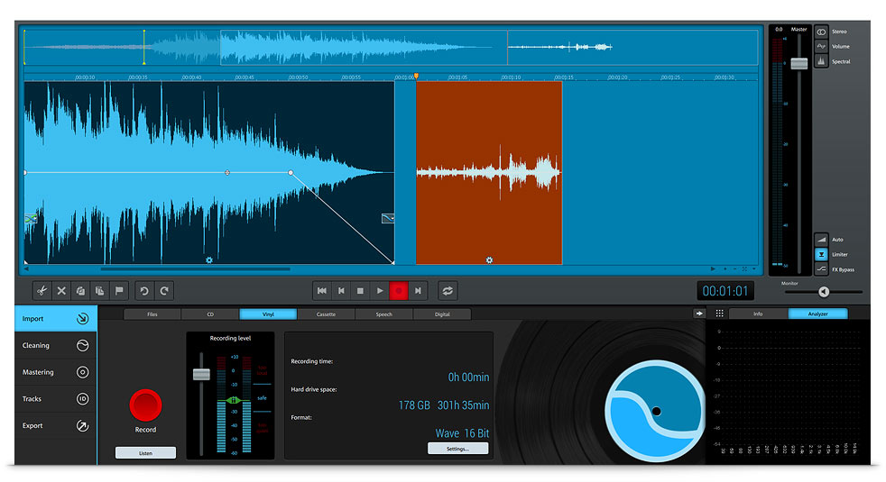
Sound Design REEL EXAMPLES DEMONSTRATING UNDERSTANDING OF THE FOLLOWING
Audio editing
Editing
Mixing

Slide 24
Reel for audio should observe the following format
Example of voice recording mixed with music (radio commercial or podcast) in MP3 or WAV format
Example of sound effects synced with visuals (game, animation, or video).
Exported as MP4 (1920X1080 H264 23.98 fps)
Example of voice synced with video (ADR or voiceover) or Interview/Dialogue with
Video. Exported as MP4 (1920X1080 H264 23.98 fps)

Slide 25

Web design and development

Slide 26
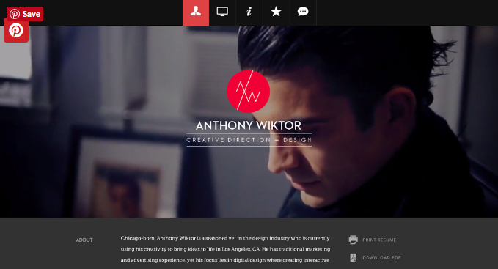
WEBSITE CREATION
Create a one page website prototype using whatever software, but Adobe XD CC is preferred, you would like having the below listed parameters: Must have a minimum of five full height sections with content. That includes text and images.
Must have four subsections with content that is appropriate to the website.
There must be a navigation bar that navigates to the full section.
Must be an eCommerce site and look professional.

Slide 27
HTML & CSS languages
You must use an external stylesheet and have correct commenting
Your HTML must be properly commented and have the correct coding structure.
Full height sections should be full height but can grow if content overflows.
Sub-sections can be a max of 50% height.
Your project must be uploaded to the Pages server.
You must show proper use of elements and styling.
Your site must be a full replication of your prototype.

Slide 28

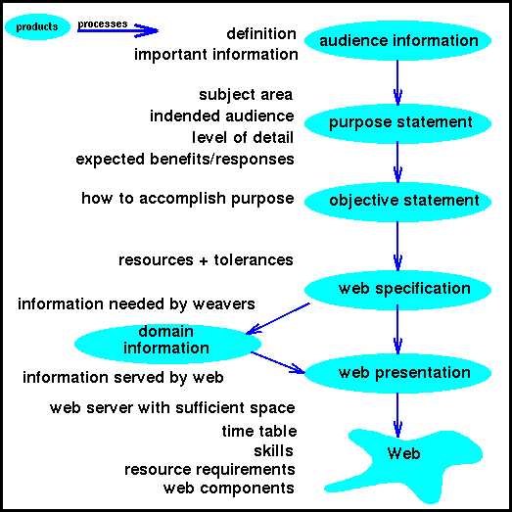
Design understanding
Include justification of design decisions
Why your decisions would increase value for a client
Who was your audience and how the design considers their needs.

Slide 29
examples
3D Graphics and Animation - https://vimeo.com/208936442
Digital Storytelling - http://www.laurenmarinigh.com/
Game Design and Development - https://biggestboss.wixsite.com/portfolio
Video Production and Sound Design - https://vimeo.com/172813382
Web Design and Development - https://iu.app.box.com/s/li7iwkpe0go0getzlsrejtcsgpdbpo9e

Slide 30
Tips for success
Start as soon as possible.
Include a breadth of work.
Consider the goal and aim.
Share the backstory.
Sell yourself.
Get feedback.

